Slide 2
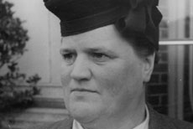
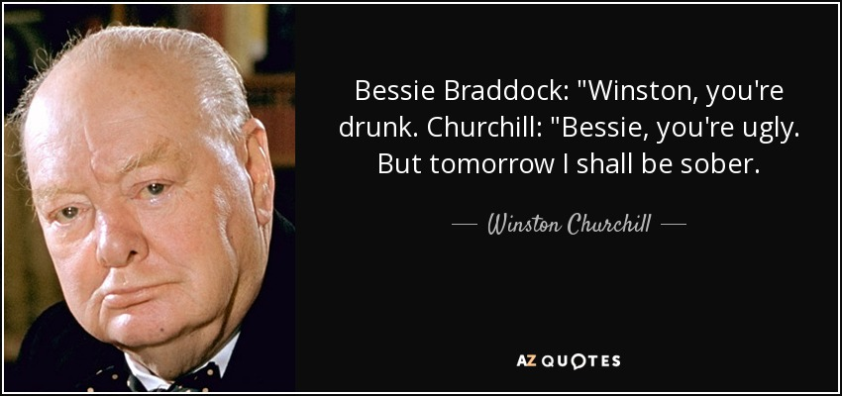

Slide 3
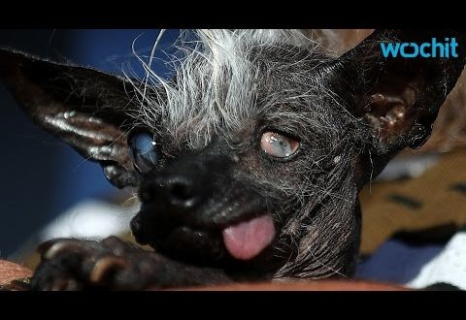
“Sweepee for President.”

Slide 4
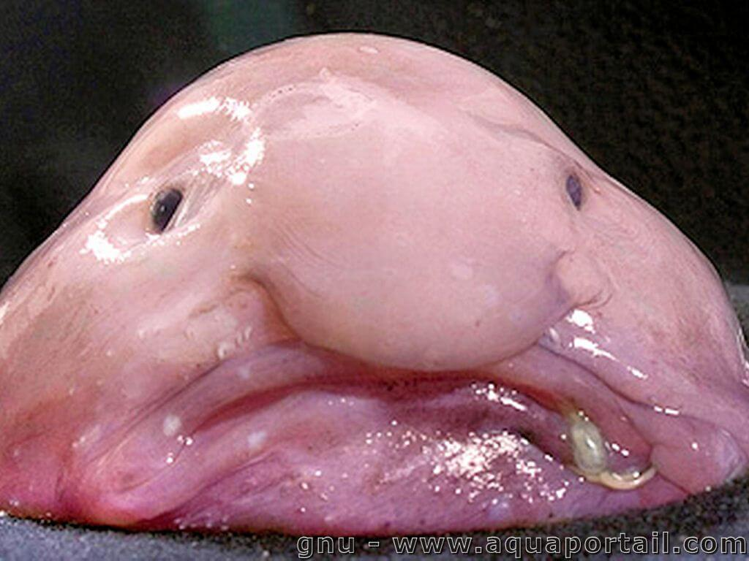

Slide 5
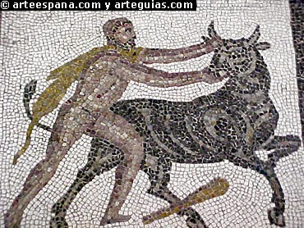
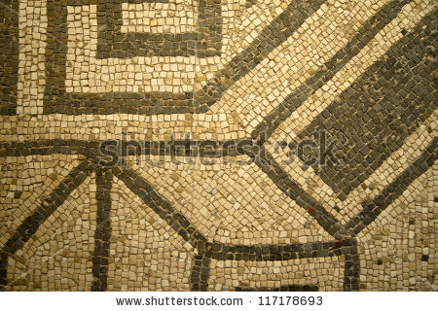
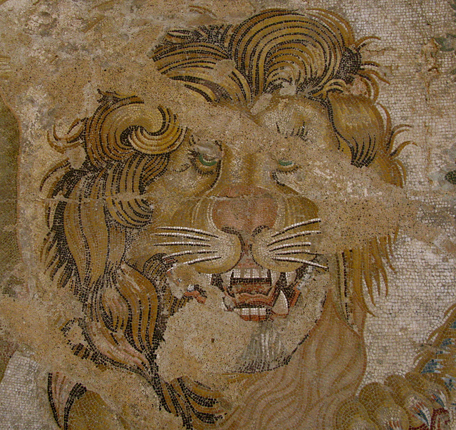

Slide 6
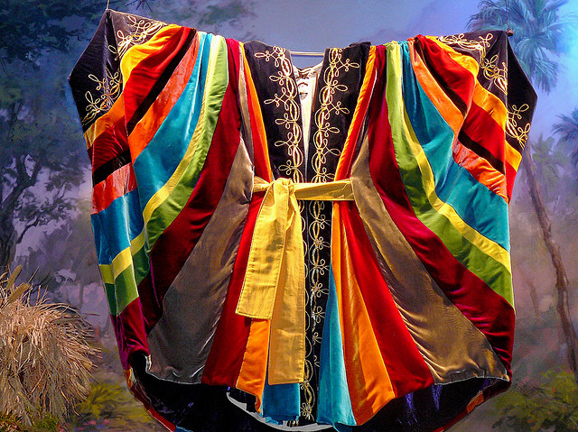
“Now Israel loved Joseph more than any of his other sons, because he had been born to him in his old age; and he made because he was the son of his old age: and he made him a coat of many colors.”
Genesis 37:3

Slide 8
Are we a healthy Body?
Authentic—practicing what we preach!
Accepting—each other’s faults!
Attentive—to each other’s strengths!
Attuned—to the Spirit’s work in all
Affectionate—Quick to hug and give the good words
Affirming—kind and winsome to those who are new or visiting
Approachable—humble enough to accept honest criticism

Slide 9
