Slide 3
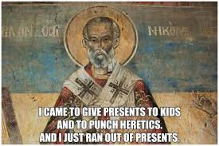

Slide 5
What should the individual Christian should do with intimate conflict;
between family, friends, lovers and spouses.
Remember the 90/10 Rule of Ignorance
First: Define the reason why? “Above all, love each other deeply, because love covers over a multitude of sins.” 1 Peter 4:8
Second: Do confrontation in private. Matthew 18:15 Keep confidences and never be guilty of gossip or slander! Ephesians 4:29-32 Let it end when it’s done! Get over it quickly, without grudge.
Third: Get your own attitude in check. Galatians 6:1
Fourth: Discern if it is worth it! 1 Corinthians 10:32-33; Ephesians 4:2
Lastly: Let the Church Mediate and Accept the Outcome willing! 1 Corinthians 6:1-8; Matthew 18:15-17

Slide 6
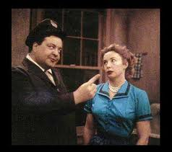
“I am the King of the House. You hear me Alice. I am the King and you’re nothing, nothing!” Alice calmly and smugly replies, “O Gee Ralph. I guess that makes you the king of nothing!”

Slide 7
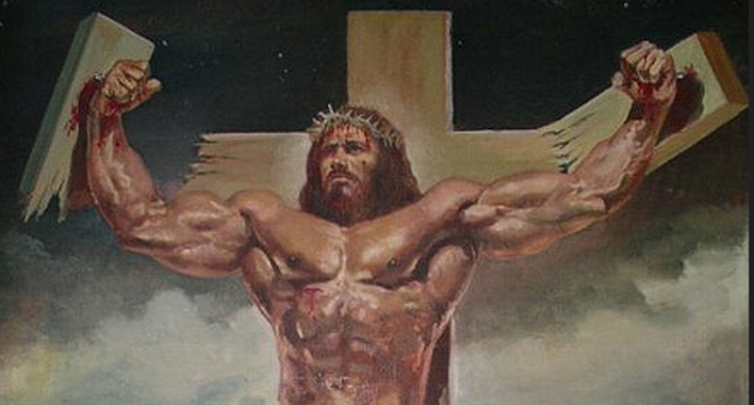
“Blessed are the peacemakers, for they will be called children of God.”
Matthew 5:9

