Slide 2
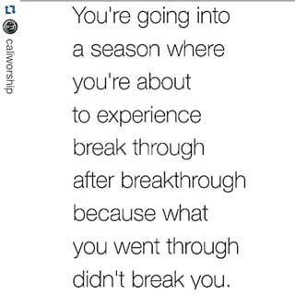
You’re going into a season where you’re about to experience break through after breakthrough because what you went through didn’t break you.
“So let's not get tired of doing what is good. At just the right time we will reap a harvest of blessing if we don't give up.”
Galatians 6:9

Slide 3
People do for others:
To get the Credit
For Come Back
For Karma
From Guilt
For Religion
For Goodness Sake

Slide 4
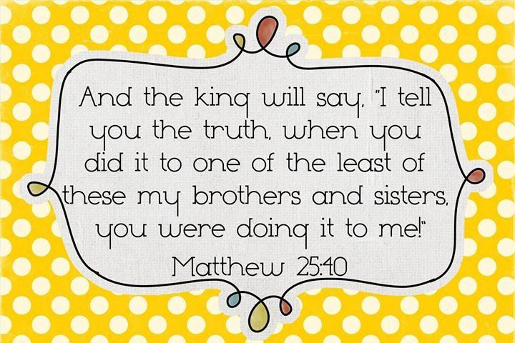

Slide 5
