Slide 1
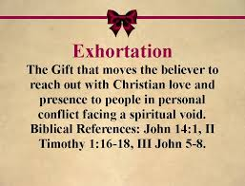

Slide 2
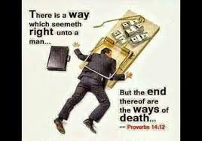

Slide 3
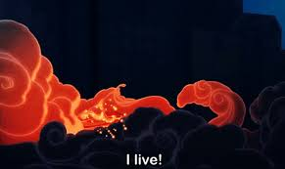
I would say LIVE!
We are a people of faith and eternity!

Slide 4
Now I would also exhort Us to Love! We are a people of agape!

Slide 5
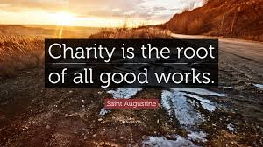
Now I
would exhort
Us to do good!

Slide 6
