Slide 2
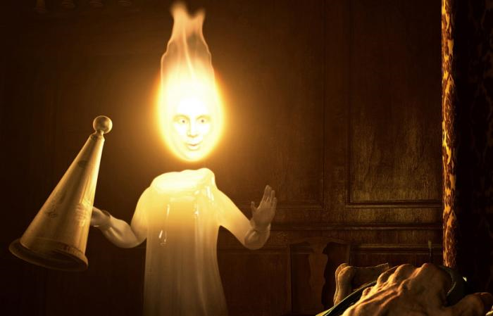
The “Ghost of Christmas Past”

Slide 3
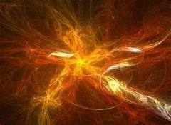
“So the Light of Israel will be for a fire, and His Holy One for a flame.”
Isaiah 10:17

Slide 4
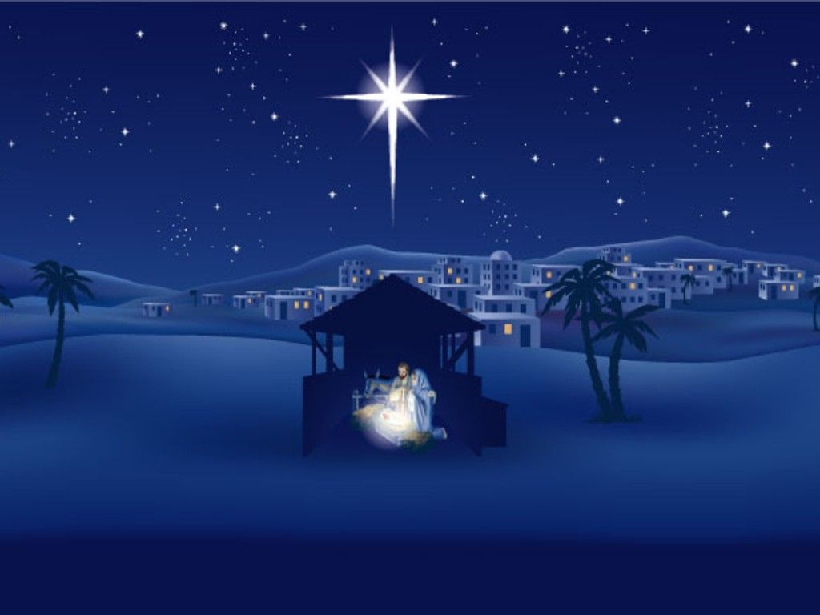

Slide 5
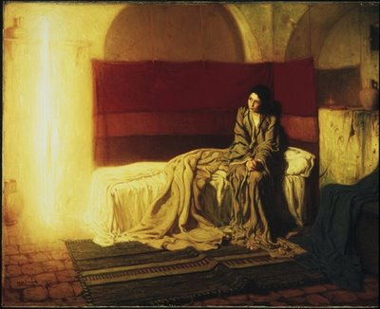
“The Holy Ghost shall intrude you, and the power of the Highest shall overshadow you.”
Luke 1:35a

Slide 6
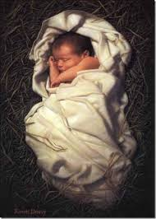
“But made himself nothing, taking the form of a servant, being born in the likeness of men.”
Philippians 2:7

Slide 7
THE HOLY GHOST IS INDEED
THE HOLY ONE!

