Slide 1
God’s View
of
Screens

Slide 2
Improved dexterity and mental acuity
Expanded knowledge base
Enhanced self-esteemed
Ease of loneliness and isolation
Social connection
Almost instant global awareness
3-D imaging
Virtual reality

Slide 3
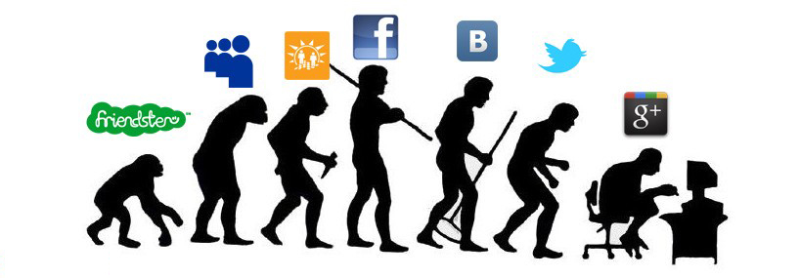
NEAR INSTANT ASSUMPTION(S)
SEXTING
PORN
BABYSITTING
LOSS OF TIME, ENERGY, RESOURCES
SET UP FOR CRIME
INCULSIVE/SINGULARITY
‘CYBER BULLYING’

Slide 4
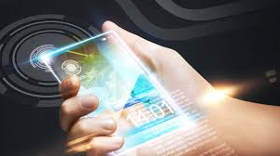
PEW RESEARCH CENTER
Internet, Science & Tech
(As of January 2014)
64% of American adults own a smartphone.
90% of American adults own a cell phone
32% of American adults own an e-reader
42% of American adults own a tablet computer
Some smartphone owners — particularly younger adults, minorities and lower-income Americans — depend on their smartphone for internet access. Of U.S. adults who own a smartphone, 7% are “smartphone-dependent.”
67% of cell owners find themselves checking their phone for messages, alerts, or calls — even when they don’t notice their phone ringing or vibrating.
44% of cell owners have slept with their phone next to their bed because they wanted to make sure they didn’t miss any calls, text messages, or other updates during the night.
29% of cell owners describe their cell phone as “something they can’t imagine living without.”
63% of adult cell owners use their phones to go online.

Slide 5
PEW RESEARCH CENTER
Internet, Science & Tech
(As of January 2014)
34% of cell internet users go online mostly using their phones, and not using some other device such as a desktop or laptop computer.
74% of adult smartphone owners ages 18 and older say they use their phone to get directions or other information based on their current location.
Among adult social media users ages 18 and older, 30% say that at least one of their accounts is currently set up to include their location in their posts.
12% of adult smartphone owners say they use a geosocial service to “check in” to certain locations or share their location with friends, down from 18% in early 2012.
Among these geosocial service users, 39% say they check into places on Facebook, 18% say they use Foursquare, and 14% say they use Google Plus, among other services.
9% of adults have texted a charitable donation from their mobile phone.

Slide 6
From Christian Counseling Today magazine
Volume 21, No. 1, page 27
90% of children age 8-16 have viewed porn
The average age of first internet exposure to porn is 11
More than 11 million teens regularly view porn online
The largest consumer of porn are boys aged 12-17
70% of men aged l8-34 visit a porn web site in a given month
One in sex women struggle with porn addiction
From: http://www.dailymail.co.uk/news/article-3034480/The-children-young-ten-feed-internet-porn-addiction.html#ixzz3XCeWuJWd
A poll of nearly 700 children by the NSPCC last week revealed that nearly one in ten 12 to 13-year-olds is worried about having an addiction to porn, while more than one in ten have made or been part of a sexually explicit video.
The disturbing results also showed that one in five of those surveyed said they’d seen pornographic images that had shocked or upset them.
This is just the latest survey to concern child welfare experts. A survey for the BBC last year found that 60 per cent of young people were 14 years old or younger when they first saw porn online.

Slide 7
A growing number of people are so desperate for people to talk with them that they will pretend to be someone else online. Many will even use an attractive picture of someone else in an attempt to try to lure others. This has become so common that this phenomenon has even been given a name. It is known as catfishing, and it has grown to epidemic levels.
If you introduce online capabilities to the value of Hyper Individualization, the result is more connectivity but also more isolation.
Communication platforms are used to promote values like Success, and Self-Image rather than actually building relationships.
Online social networks enable relationship QUANTITY over relational QUALITY. A more addicting quality of our online presentation of ourselves is that we have “editing” capabilities. We can begin to actually prefer online interaction because we are our own Public Relations specialists.

Slide 8
The video says that this creates a cycle. We are lonely but afraid of intimacy. Online world offers us three gratifying fantasies:
We can give attention to whatever we want. We control our flow of information.
We will always be heard. Blogging, tweeting, Facebook, texting.
Therefore we are never alone.
QUOTED FROM:
“The Loneliest Generation?”
Date: October 2, 2013
Author: Rachel Gall

Slide 9
Sexual addiction otherwise known as compulsive sexual behavior is associated with serious psychosocial problems and risk-taking behavior. This study used the Cybersex addiction test, Craving for pornography questionnaire, and a Questionnaire on intimacy among 267 participants (192 males and 75 females who were recruited from special sites that are dedicated to pornography and cybersex on the Internet).
Results of regression analysis indicated that pornography, gender, and cybersex significantly predicted difficulties in intimacy and it accounted for 66.1% of the variance of rating on the intimacy questionnaire.
Second, regression analysis also indicated that craving for pornography, gender, and difficulties in forming intimate relationships significantly predicted frequency of cybersex use and it accounted for 83.7% of the variance in ratings of cybersex use.
Third, men had higher scores of frequency of using cybersex than women and higher scores of craving for pornography than women And no higher scores on the questionnaire measuring difficulties in forming intimate relationship than women

Slide 11
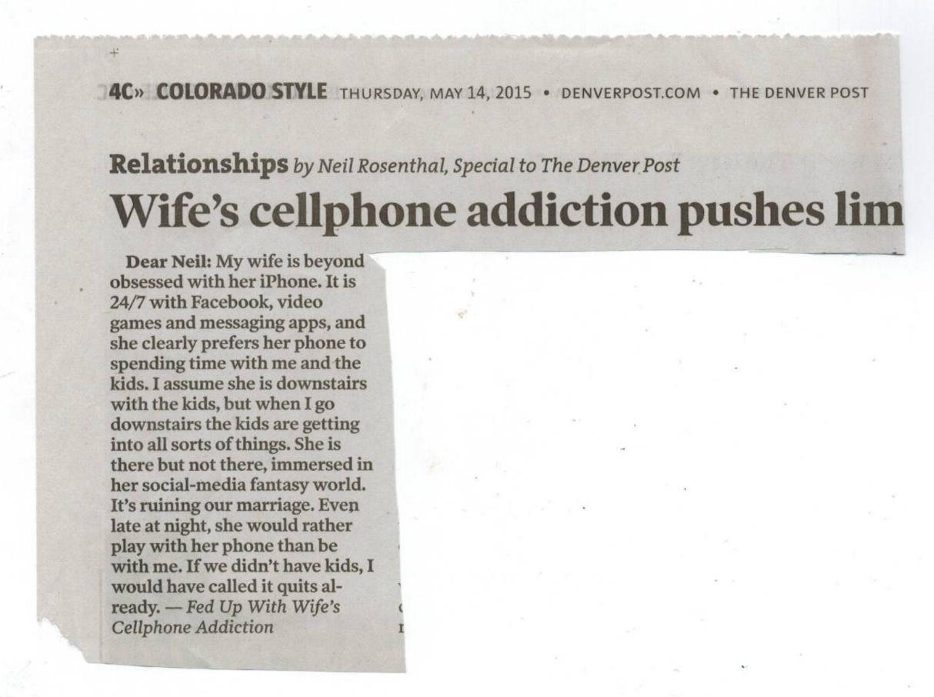
Dear Neil: My wife is beyond obsessed with her iPhone. It is 24/7 with Facebook, video games and messaging apps, and she clearly prefers her phone to spending time with me and the kids. I assume she is downstairs with the kids, but when I go downstairs the kids are getting into all sorts of things. She is there but not there, immersed in her social-media fantasy world. It's ruining our marriage. Even late at night, she would rather play with her phone than be with me. If we didn't have kids, I would have called it quits already.
Fed Up With Wife’s Cellphone Addiction

Slide 12
NOW-WHAT DOES GOD SAY?

Slide 13
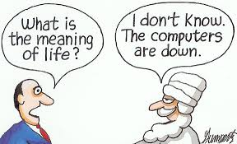
NOW-WHAT DO WE DO?
Keep a healthy Skepticism about Emerging Technology
Monitor ‘Screen Use’ (How Much?)
Refuse to Sub Screen’s for True-Life Communication, Parenting or Touching
Don’t use Screens for “Personal or Intimate Talk or Viewing”
SOMETIMES LAY ASIDE SCREENS AS A OFFERING TO THE LORD

Slide 14
