Slide 2
Nervous
Nellie

Slide 3
90/10 Rule of Ignorance
Most of it is Stupidity
Some of it is good for the heart, mind and body
All the rest should be rebuked
Use Discernment in application

Slide 4
“Look at the birds of the air: they neither sow nor reap nor gather into barns, and yet your heavenly Father feeds them. Are you not of more value than they?”
Matthew 6:26

Slide 5
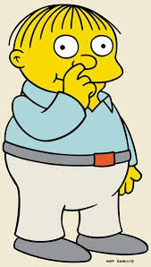
Two issues contribute to present time, unwelcomed baggage. These are:
Besetting Habits: (Hebrews 12:1b) is intriguing “Let us throw off everything that hinders and the sin that so easily entangles.”
Misapplied Temper: “Do not let the sun go down while you are still angry.” (Ephesians 4:26) Get over yourself! It’s just not worth it! And if it is, do something constructive to heal or repair or let it go!

Slide 6
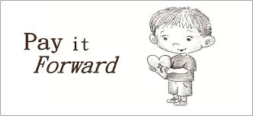

Slide 7
Learn these three skills and do them.
Negotiate which means to: obtain or bring about by discussion, get it arranged, broker a deal, work it out, thrash to agreement. Negotiation also means to: find a way over or through an obstacle, get around it, get past it or get over it.
Compromise which means to: come to an agreement or a settlement of a dispute that is reached by each side making concessions or by meeting each other halfway to strike a balance or find a happy medium.
Be Affectionate which means to: be readily feeling or showing fondness or tenderness.

Slide 8
Travel Light!

