Slide 2
MAXIMIZING YOUR SPIRITUAL LIFE BEING NEW IN THE FAITH
KNOW FIRST THAT ONE IS TRANSLATED, SANCTIFIED AND PLACED INTO THE BODY OF CHRIST

Slide 3
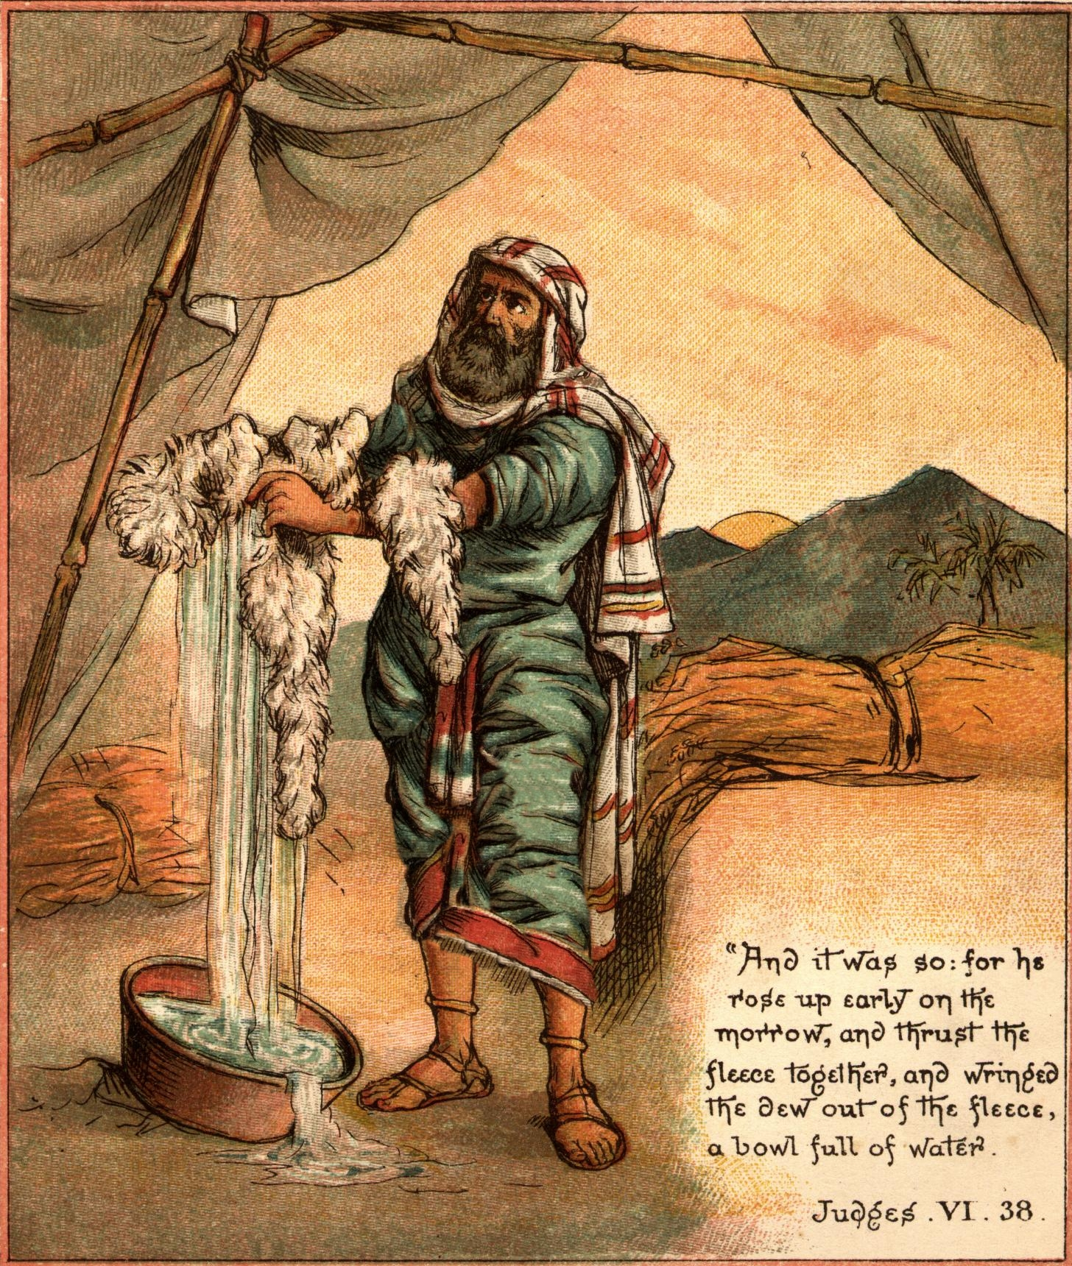
Testing or fleecing God will occur.

Slide 5
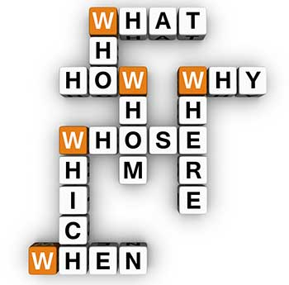
Mythology Theology Will Overwhelm.
One will Question Community.
Discouragement will Fade the Zeal.

Slide 6
We then must maximize—to grow up and walk
How?
Refuse the bait to ‘test God’s love’ in some magical manner
Do not linger in doubt
Study to show yourself approved unto God
Celebrate in Community
Stay in the Journey

