Slide 2
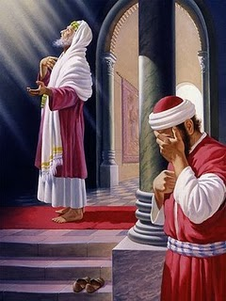
The Pharisee stood and prayed thus with himself, “God, I thank you that I am not like other men — extortioners, unjust, adulterers, or even as this tax collector. I fast twice a week; I give tithes of all that I possess.’ And the tax collector, standing afar off, would not so much as raise his eyes to heaven, but beat his breast saying, ‘God, be merciful to me a sinner!” Luke 18:10-13

Slide 3
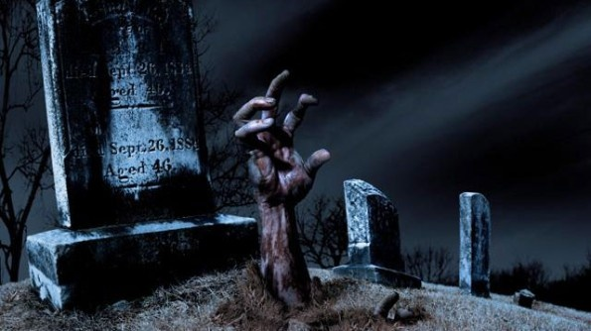
He was greedy in life, be damned in death.

Slide 4
Causes of GALL and the ANTIDOTE for each
Trials and Tribulations: Events and Circumstances not of our making:
Antidote: A thankful heart.
Problems and Concerns: Consequences and Incidents of worry we bring to ourselves.
Antidote: A Thankful Mind
Trauma and Terror: Paranormal Evil that attacks us.
Antidote: A Thankful Soul

Slide 5
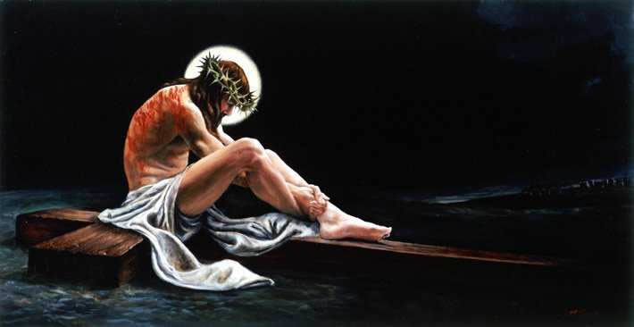
“For this is thankworthy, if anyone in conscience understanding toward God; endures hardship unjustly.” 1 Peter 2:19
“Who when He was reviled, reviled not again; when He suffered, He threatened not; but committed to That One who discerns righteously.” 1 Peter 2:23

Slide 6
The benefits of assuming a thankful and grateful resonance, no matter what assails Us?
There are many indeed. To aid our memory, they all begin with the letter ‘R.’
Reasonableness: THANK YOU!
Release: THANK YOU!
Relief: THANK YOU!
Redemption: THANK YOU!
Reciprocation: THANK YOU!
Reconciliation: THANK YOU!
Reflection: THANK YOU!
Recuperative Rest: THANK YOU!

Slide 7
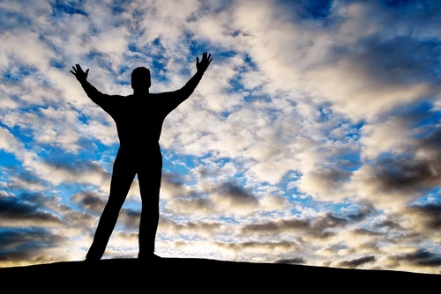
“In everything give thanks: for this is the will of God in Christ Jesus concerning you!”
1 Thessalonians 5:18

