Slide 2
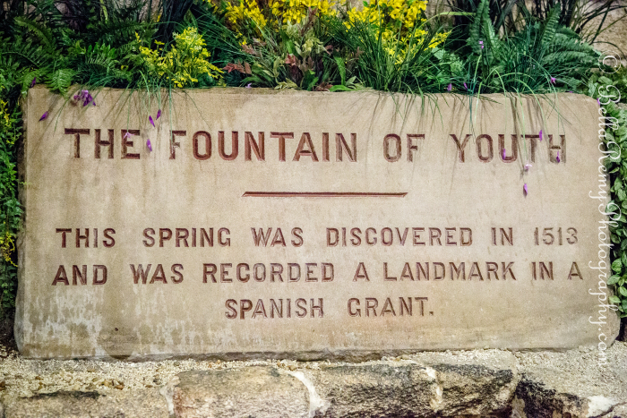

Slide 3
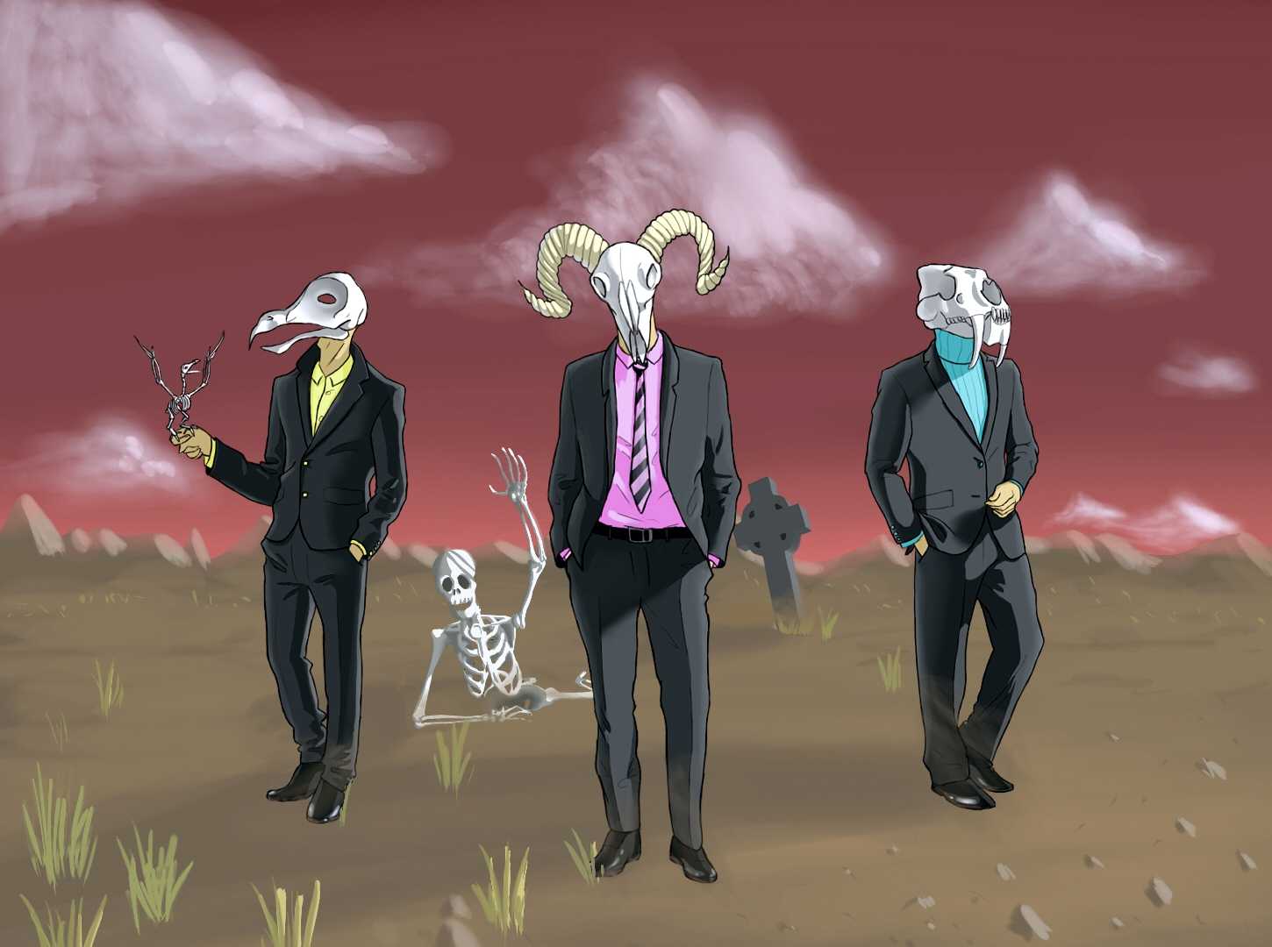
Prior to enlightenment, the human body is dying, going dead from the inside out. An alien virus lives within, awaiting eruption to steal away innocence. Our soul is also dead, encapsulated by an erratic conscience that cannot choose to ‘do or be good enough’ for Creator’s purpose.

Slide 4
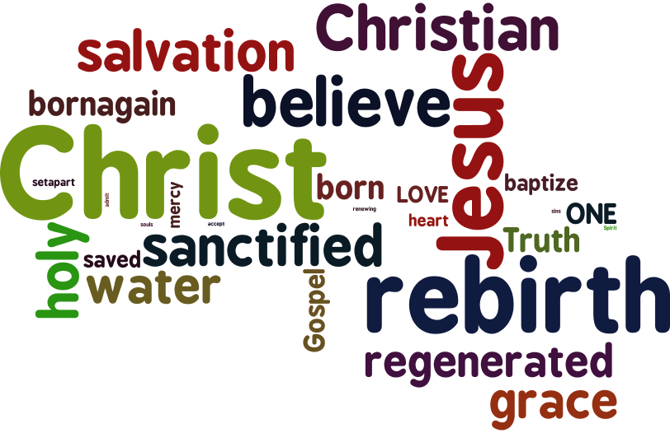
This is the first rejuvenation—our Salvation.

Slide 5
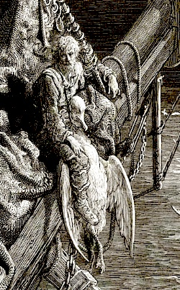
“Water, water, everywhere, And all the boards did shrink; Water, water, everywhere, Nor any drop to drink.”

Slide 6
Rejuvenation in tribulation!
Heed these verses by our great apostles:
“And not only this, but we also exult in our tribulations, knowing that tribulation brings about perseverance.”
Romans 5:3
“Rejoicing in hope, persevering in tribulation, devoted to prayer.”
Romans 12:12
“Now I rejoice in my sufferings for your sake, and in my flesh, I do my share on behalf of His body, which is the church, in filling up what is lacking in Christ's afflictions.”
Colossians 1:24

Slide 7
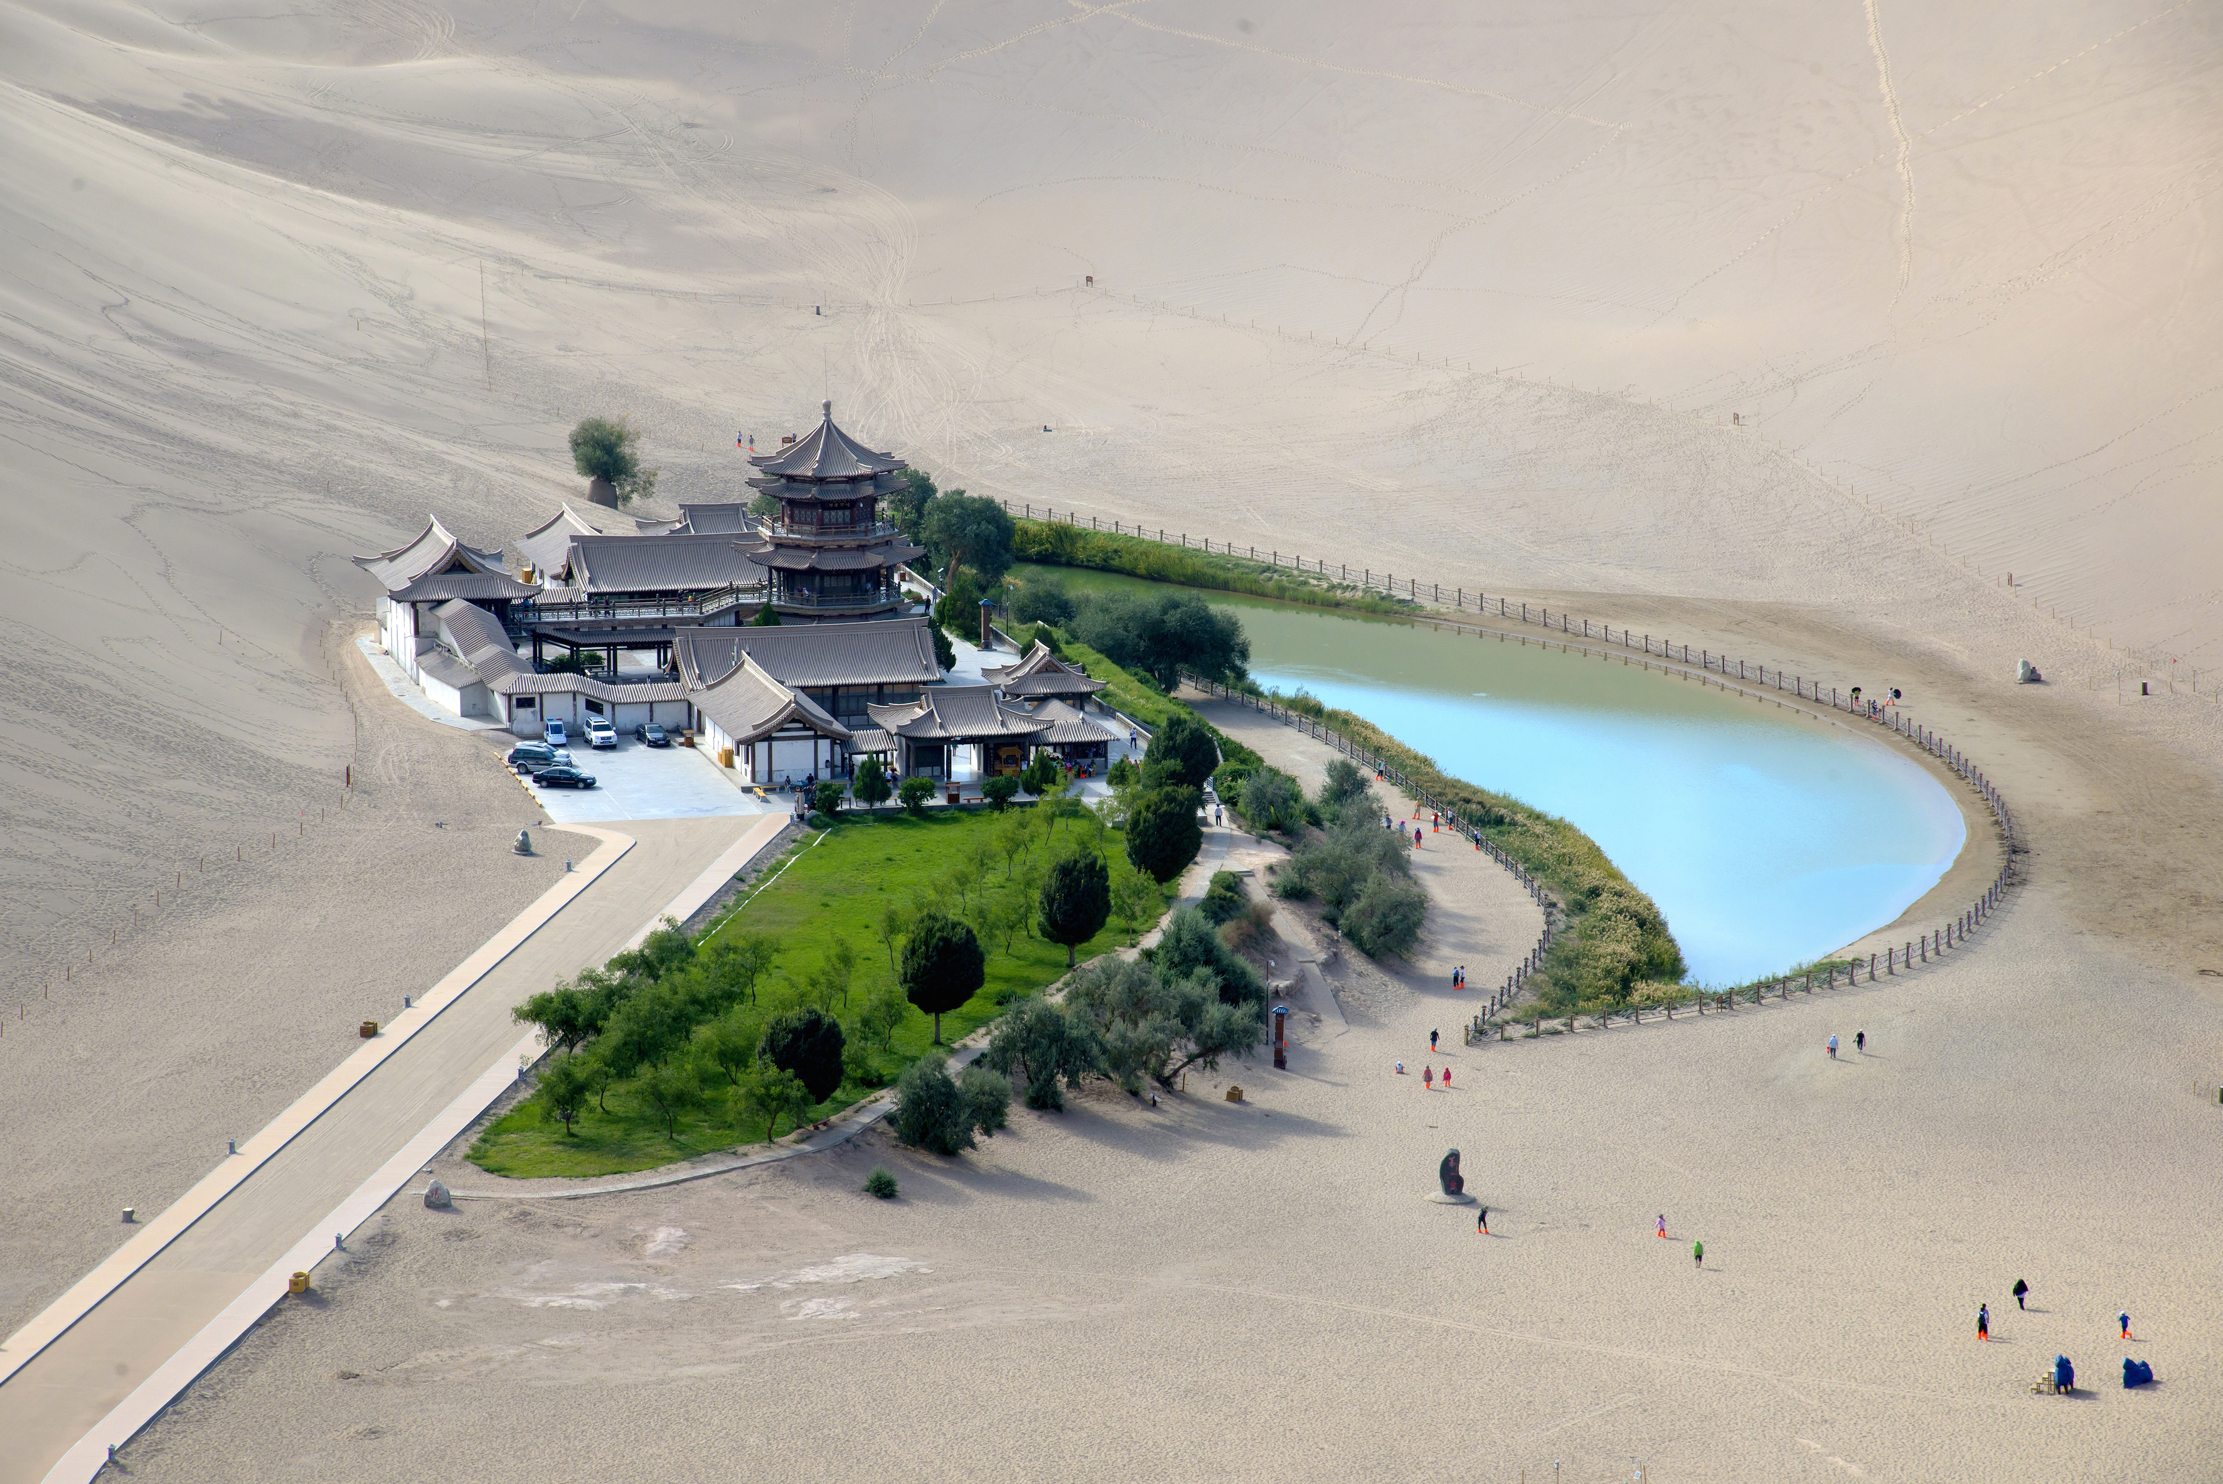

Slide 9
