Slide 1
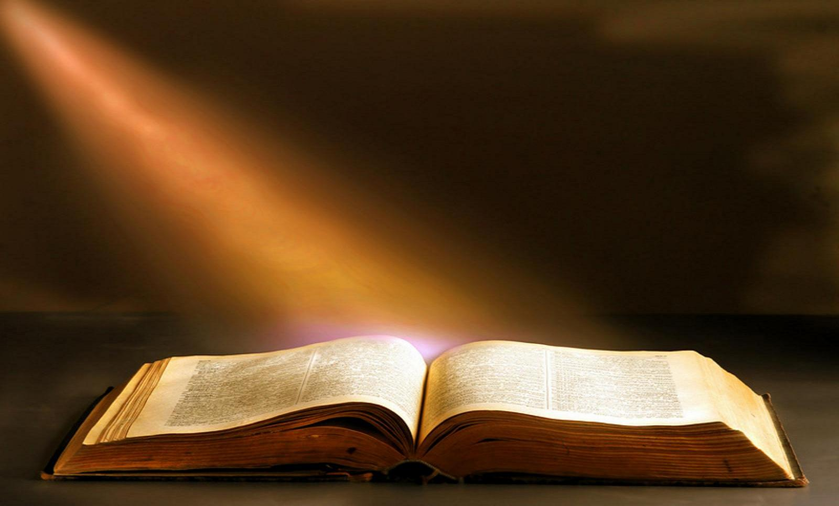
I
Thank God
For His Mercy
For His Wisdom
Notes:
For His Mercy
1. compassionate or kindly forbearance shown toward an offender, an enemy, or other person in one's power; compassion, pity, or benevolence: Have mercy on the poor sinner.
2. the disposition to be compassionate or forbearing: an adversary wholly without mercy.
3. the discretionary power of a judge to pardon someone or to mitigate punishment
5. something that gives evidence of divine favor; blessing:
For His Wisdom
Men through out all existence have tried to espouse worldly wisdom devoid of God Paul calls it “Idle babbleings” ( Athens)
True wisdom can only be found in the pages of this book (Bible), or the lives and hearts of believers

Slide 2
I
Thank God
For His Might
For His Provision
Notes:
For His Might – true power found in God sometimes ( alo ) found in Mercy and Grace
For His Provision for our sustainace physical (our food and water) and emotional (peace) and our spiritual

Slide 3
I
Thank God
For His Grace
For His Body
Notes:
For Grace-1 Corinthians 1:4
I thank my God always concerning you for the grace of God which was given to you by Christ Jesus,
We talked earlier about “Mercy” Hebrew word synonymous with Greek word “grace” David seemed to have a grasp on mercy He was called a “man after God’s own Heart” How much more can our grasp on Grace be we have The Spirit indwelling ouir heart and the mind of Christ
For His Body Paul closes letters he wrote thanking God for the members of the BOC. He even knew that what was in store for us was greater then what this world offered but the ministry that he was given was more important then h

Slide 4
I
Thank God
How Do We Thank God
Through Prayer
Through Music / Song
Notes:
Through Prayer
Through Music / Song Music seems to play a big part

Slide 5
I
Thank God
How Do We Thank God
Through Our Actions
Through our Attitude
Notes:
Through Our Actions Eph 5: 4 “ neither filthiness, nor foolish talking, nor coarse jesting, which are not fitting, but rather giving of thanks.”
- Through our attitude 1 Thes 5:18 in everything give thanks; for this is the will of God in Christ Jesus for you.

Slide 6
I
Thank God!!
Notes:
How ever we do it it seems imperative that we THANK GOD!!!!!

