Slide 2
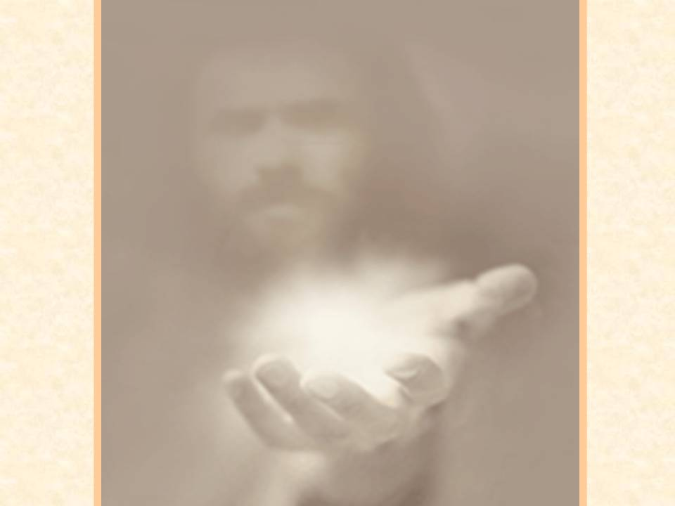
A
T
T
I
T
U
D
E
“ATITIUDE DETERMINES YOUR ALTITUDE”
Notes:
Several years ago I built out a business that made flight simulators for commercial pilots. While we were there I had the opportunity to try out the simulators.
As I did , I noticed several of the gauges and instruments. So, being the inquisitive person that I am I started asking questions about different things and what they were for. One of the gauges was the attitude indicator. The attitude of an airplane determines its nose position. So, if you have a nose pointing up attitude, you’re climbing. If you have a nose pointed down attitude, you’re descending. The attitude of the plane determines whether it’s going up or diving down. The same is true of the Christian life. There are Christians who exhibit a nose pointed up attitude and their walk with God climbs. Others, have a nose pointed down attitude and dive into some most needless things of life. It’s been said: Attitude almost always determines your altitude in life.

Slide 3
A
T
T
I
T
U
D
E
POINTED?
W
ALK
W
I
TH
CH
I
ST
UP
DOWN
Notes:
The attitude that we have as Christians also has a tremendous impact on the vitality and the success of our walk with Christ. Positive Negative Possibilities Problems Opportunities Obstacles Dreams Difficulties See the best in people See the worst in people Move forward Move backward Praise others Criticize others
One of the greatest challenges in the Christian walk is to remain positive for Christ in a negative and confused world. Our attitude shapes the kind of walk with God that we will experience.

Slide 4
A
T
T
I
T
U
D
E
“ CONSIDER IT ALL
JOY ”
JOY
Notes:
Philippians 4:4-9 (NKJV)
⁴ Rejoice in the Lord always. Again I will say, rejoice!
⁵ Let your gentleness be known to all men. The Lord is at hand.
⁶ Be anxious for nothing, but in everything by prayer and supplication, with thanksgiving, let your requests be made known to God; ⁷ and the peace of God, which surpasses all understanding, will guard your hearts and minds through Christ Jesus.
⁸ Finally, brethren, whatever things are true, whatever things are noble, whatever things are just, whatever things are pure, whatever things are lovely, whatever things are of good report, if there is any virtue and if there is anything praiseworthy—meditate on these things. ⁹ The things which you learned and received and heard and saw in me, these do, and the God of peace will be with you.
The action of rejoicing is allowing your life to be filled with the supernatural joy of heaven. It is allowing God to fill your life with His presence. It is allowing the atmosphere of heaven to flood your soul. To rejoice is to be given an undefinable strength and undefeated gladness. Rejoicing is allowing the insuppressible spirit of heaven to spill over into every area of your life and then have it overflow to the lives of others. True joy can never be contained and it can never be confined.
Real joy impacts the way that we live and changes us. Joy is transforming and inspiring. Real joy has absolutely nothing to do with situations, circumstances or anything of this earth. Real is the found in the greatness of knowing Christ, having His presence in your life and seeking His Kingdom with your life. It is this joy that gives us the ability to thrive in the daily grind of life.
Paul tells the Philippians to allow their gentleness to be evident. The word gentleness literally means to be fair minded. The term refers to a social or political justice and gives an understanding that there is something higher and better than earthly justice. God acts above the mere letter of the Law and extends grace and mercy to us. Paul is telling the Philippians that they are given a justice better than what is on earth. Gentleness is a strength under criticism, harshness or personal attacks. Gentleness is not a lack of defending yourself but rather it is not giving a counter attack. Peter says we are not to return evil for evil but overcome evil with good. Gentleness is rising above low behavior. We are never to strike back at those that hurt us.

Slide 5
A
T
T
I
T
U
D
E
PEACE
BOUND
WOVEN TOGETHER
UNITED
HOLY SPIRIT
Notes:
The word peace means to be bound, woven together or united. The only way that we can ever truly experience peace is when our lives are bound and united with God through Christ. The reason that most people become negative and critical is because they lack this essential peace.
The Holy Spirit is the one who gives us that ability to really become united.
Here at GBC in our leadership teams we have unanimous consent. That means that there is no decisions made unless the vote is 100% agreement.
We rely on the Holy Spirit to give us clarity and unity.
Many times people never really release there burdens, they never give them to God. They continually give them to friends , family , pastors but never really give them to God.
Here is a good rule of thumb that works with most issues
1.) Pray - take your concerns to God If something isn’t important enough for you to pray about then it isn’t important enough to complain or worry about. 2.) Talk - share your concerns Molehills become mountains if they are left over time. Most minor problems can be solved easily and are never given the opportunity to grow. 3.) Let it go Really let it go

Slide 6
A
T
T
I
T
U
D
E
POSITIVITY
Notes:
People who immerse them selves in negativity have negative consequences
Paul in Gal. puts it this way
Galatians 6:7-8 (NKJV)
⁷ Do not be deceived, God is not mocked; for whatever a man sows, that he will also reap. ⁸ For he who sows to his flesh will of the flesh reap corruption, but he who sows to the Spirit will of the Spirit reap everlasting life.
In Philippians we read earlier Paul gave us a list of the things to meditate on. All these thing were positive not negative things.
You need to figure out how that works in your life. For me it took avoiding watching news. News gets me focusing on the negative asspects of this world and takes me away from focusing on the positive.

Slide 7
A
T
T
I
T
U
D
E
A
L
T
I
T
U
D
E
Notes:
Conclusion Words can never adequately convey the incredible impact of our attitude toward life. The longer I live the more convinced I become that life is 10 percent what happens to us and 90 percent how we respond to it. I believe the single most significant decision I can make on a day-to-day basis is my choice of attitude. It is more important than my past, my education, my bankroll, my successes or failures, fame or pain, what other people think of me or say about me, my circumstances, or my position. Attitude keeps me going or cripples my progress... It alone fuels my fire or assaults my hope. When my attitude is right, there’s no barrier too high, no valley too deep, no dream too extreme, no challenge too great for me. - Charles R. Swindoll, Strengthening Your Grip The noted English architect Sir Christopher Wren was supervising the construction of a magnificent cathedral in London. A journalist thought it would be interesting to interview some of the workers, so he chose three and asked them this question, "What are you doing?" The first replied, "I’m cutting stone for 10 shillings a day." The next answered, "I’m putting in 10 hours a day on this job." But the third said, "I’m helping Sir Christopher Wren construct one of London’s greatest cathedrals." Source Unknown. The choice is yours today. Are you going to come into church each week with miserable attitude and make others around you miserable in the process or are you going to help Jesus build His church? Are you going to live with your attitude indicator pointing down or are you going to look up and climb in life with Christ? Your attitude is your choice. Why not commit your attitude to Christ and ask for His help and guidance?

