Slide 2
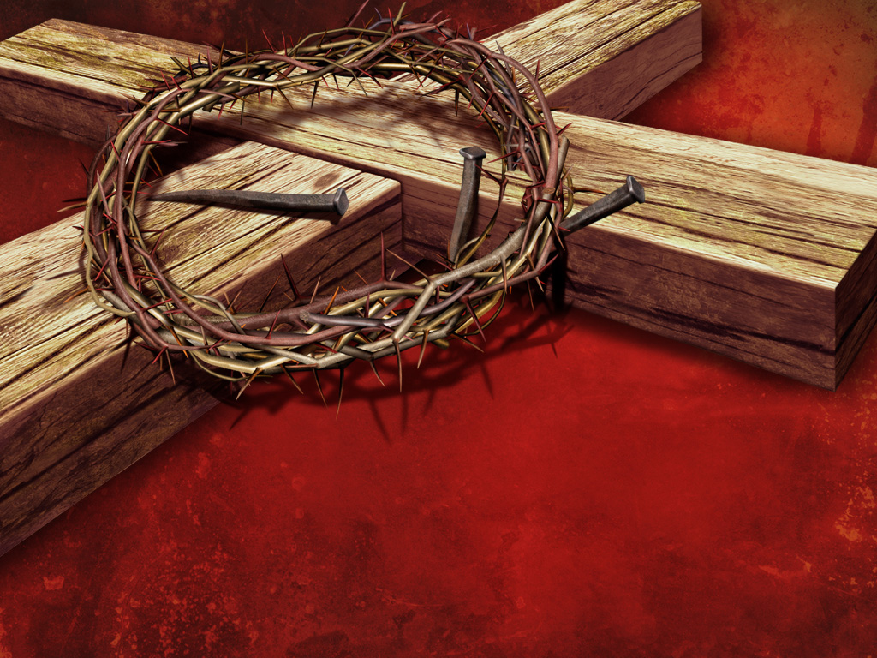
AUTHENTICITY OF THE SON

Slide 3
AUTHENTICITY
CHRIST’S
LOVE
Notes:
John 13:34
A new commandment I give to you, that you love one another; as I have loved you, that you also love one another.
Matthew 5:43-44
43 “You have heard that it was said, ‘You shall love your neighbor[a] and hate your enemy.’ 44 But I say to you, love your enemies, bless those who curse you, do good to those who hate you, and pray for those who spitefully use you and persecute you,
John 16:27
for the Father Himself loves you, because you have loved Me, and have believed that I came forth from God.
Romans 5:8-9New King James Version (NKJV)
8 But God demonstrates His own love toward us, in that while we were still sinners, Christ died for us.
Romans 8:35
Who shall separate us from the love of Christ? Shall tribulation, or distress, or persecution, or famine, or nakedness, or peril, or sword?

Slide 4
AUTHENTICITY
CHRIST’S commitment
Notes:
Rom 8:35,37-39
35 Who shall separate us from the love of Christ? Shall tribulation, or distress, or persecution, or famine, or nakedness, or peril, or sword?
37 Yet in all these things we are more than conquerors through Him who loved us. 38 For I am persuaded that neither death nor life, nor angels nor principalities nor powers, nor things present nor things to come, 39 nor height nor depth, nor any other created thing, shall be able to separate us from the love of God which is in Christ Jesus our Lord.

Slide 5
AUTHENTICITY
CHRIST’S sacrifice
Notes:
John 10:17
“Therefore My Father loves Me, because I lay down My life that I may take it again.
Luke 22:41-43New King James Version (NKJV)
41 And He was withdrawn from them about a stone’s throw, and He knelt down and prayed, 42 saying, “Father, if it is Your will, take this cup away from Me; nevertheless not My will, but Yours, be done.” 43 Then an angel appeared to Him from heaven, strengthening Him.
Galatians 2:20
I have been crucified with Christ; it is no longer I who live, but Christ lives in me; and the life which I now live in the flesh I live by faith in the Son of God, who loved me and gave Himself for me.

Slide 6
AUTHENTICITY
CHRIST’S Identity
Notes:
Our Identity in Christ confirms His authenticity
We have eternal existence
We are His children and have Christ’s inheritance
We have eternal security
We are members of the Body of Christ
We are indwelt by the H.S.

