Slide 2
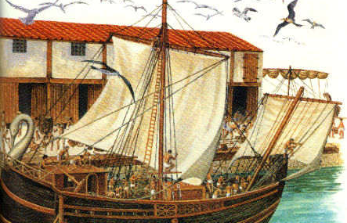
“From Miletus he (Paul) was sent to Ephesus and called for the elders of the church.”

Slide 3
I would point out Paul’s characteristics, detailing them from our scripture reading.
Complete and total commitment
Ownership of his calling
Willingness to accept consequences
Compulsion to evangelize
Offering his service without expectation of recompense
Charging others to likeminded in generosity, compassion and edification
And why do these traits matter?

Slide 4
Complete and total commitment

Slide 5
Ownership of His calling

Slide 6
Willingness to accept consequences

Slide 7
COMPULSION TO EVANGELIZE

Slide 8
Offering his service without expectation of recompense

Slide 9
Charging others to likeminded in generosity, compassion and edification

