Slide 2
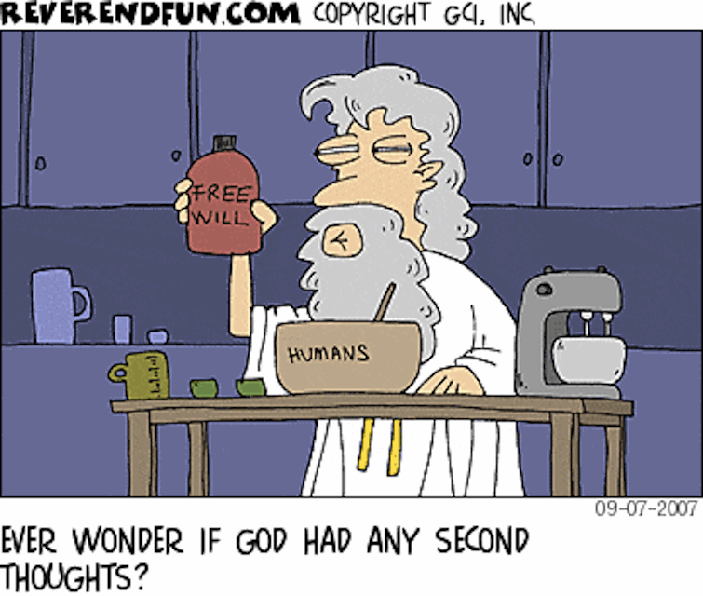

Slide 3
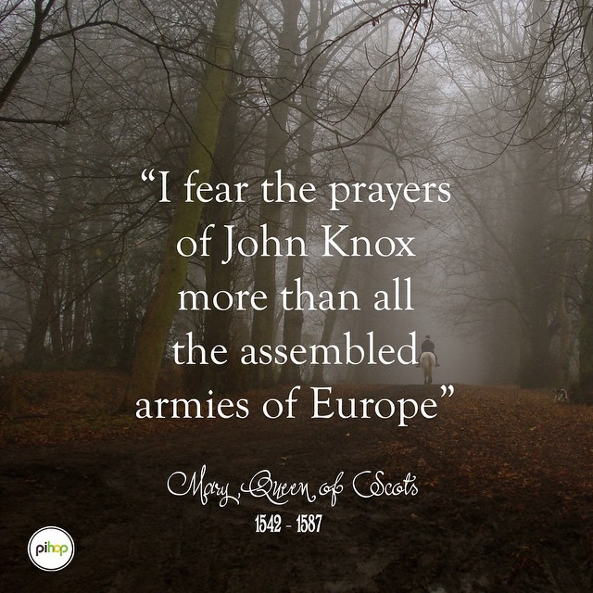

Slide 5
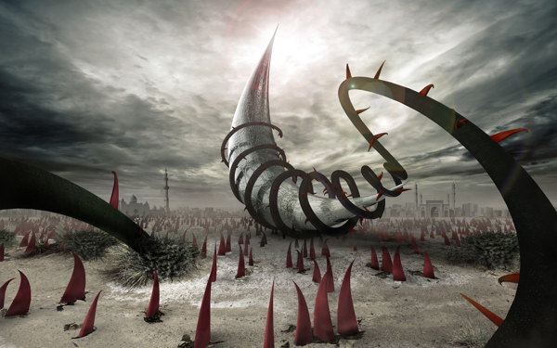

Slide 6
“This day I call the heavens and the earth as witnesses against you that I have set before you life and death, blessings and curses. Now choose life, so that you and your children may live.”
Deuteronomy 30:19

Slide 7
Here’s a good way to choose the blessings of life.
“Dear friends, do not believe every spirit, but test the spirits to see whether they are from God, because many false prophets have gone out into the world.” If something does not align with the Word of God—it’s likely wrong!
I John 4:1
Seek Godly Counsel and do not seek your own way. Good advice is often painful to hear.
Talk directly to Holy Spirit. Once accustomed to this 2-way communication, the thrill is like have insider knowledge to the workings of Angels and the Living Word.
Stay flexible, temperate, moderate and as far as possible, be at peace with the human drama. We are His beloved and we should lead The Way.

