Slide 2
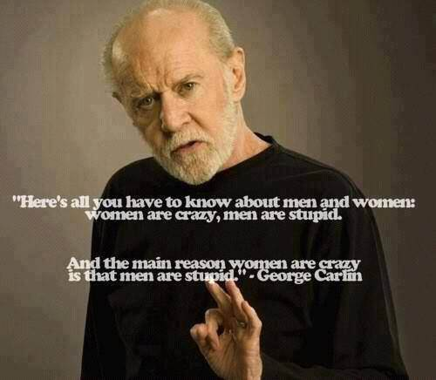

Slide 3
However, the sciences have arrived at some fundamental distinctive in at least these three basic, male arenas:
Biology: It seems obvious. ‘Men have men parts.’
Phenomenology: Males perceive, sense and experience from conscientiousness other than female, with a tendency toward aggression. They are quick to war— and quicker to make peace than their counterparts.
Sociologically: Yes. It is true. Guys like hanging out with guys, doing guy things. They don’t do well being alone, though they are prone to stray when novelty or desires wanes.

Slide 5
“Just as Christ loved the church and gave Himself up for Her.”
Ephesians 5:25

Slide 6
The word ‘head’ means ‘source’ (like the headwater of the Nile is Lake Victoria). Therefore, God is the source of Christ, and Christ is the source of Man and Man is the source of Woman!

