Slide 3
Acts 20:17-38
From Miletus he (Paul) was sent to Ephesus and called for the elders of the church. And when they had come to him, he said to them: You know, from the first day that I came to Asia, in what manner I always lived among you, serving the Lord with all humility, with many tears and trials which happened to me by the plotting of the Jews; how I kept back nothing that was helpful, but proclaimed it to you, and taught you publicly and from house to house, testifying to Jews, and also to Greeks, repentance toward God and faith toward our Lord Jesus Christ. And see, now I go bound in the spirit to Jerusalem, not knowing the things that will happen to me there, other than that which the Holy Spirit testifies in every city, saying that chains and tribulations await me. But none of these things move me; nor do I count my life dear to myself, so that I may finish my race with joy, and the ministry which I received from the Lord Jesus, to testify to the gospel of the grace of God. And indeed, now I know that you all, among whom I have gone preaching the kingdom of God, will see my face no more. Therefore, I testify to you this day that I am innocent of the blood of all men. For I have not shunned to declare to you the whole counsel of God. Therefore, take heed to yourselves and to all the flock, among which the Holy Spirit has made you overseers, to shepherd the church of God which He purchased with His own blood. For I know this, that after my departure savage wolves will come in among you, not sparing the flock. Also, from among yourselves men will rise up, speaking perverse things, to draw away the disciples after themselves. Therefore, watch and remember that for three years I did not cease to warn everyone night and day with tears. So now, brethren, I commend you to God and to the word of His grace, which is able to build you up and give you an inheritance among all those who are sanctified. I have coveted no one’s silver or gold or apparel. Yes, you yourselves know that these hands have provided for my necessities, and for those who were with me. I have shown you in every way, by laboring like this, that you must support the weak. And remember the words of the Lord Jesus, that He said, ‘It is more blessed to give than to receive.’ And when he had said these things, he knelt down and prayed with them all. Then they all wept freely, and fell on Paul’s neck and kissed him, sorrowful about most of all for the words which he spoke, that they would see his face no more. And they accompanied him to the ship.

Slide 4
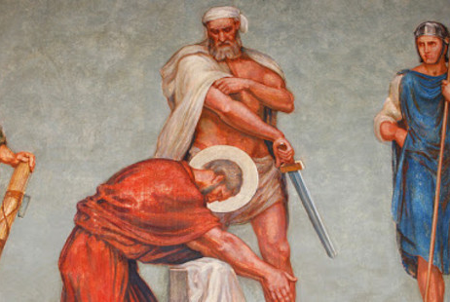
“I have fought a good fight, I have finished my course, I have kept the faith.”
2 Timothy 4:7
Paul was never afraid to die or to speak the Gospel Truth.

Slide 5
Transparency in His Calling
First in His Mission

Slide 6
Transparency in His Calling
Second in His Ministry

Slide 7
Transparency in His Calling
Finally in His Message

Slide 8
Our church needs a fresh commitment, a new vision and a broad hope for our community.
Our church needs an in-reach and outreach, vitality and spiritual renewal. We need
not be discouraged in offering our Mission, Ministry and Message. We may need to
look at our Methods. Pray hard about this and let Us come together and work this out!

