Slide 2
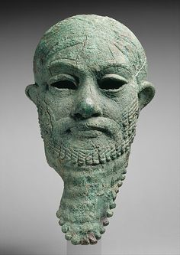
“And as Jesus passed by, He saw a man which was blind from his birth. And his disciples asked him, saying, ‘Master, who did sin, this man, or his parents,
that he was born blind? ‘Jesus answered, ‘neither hath this man sinned, nor his parents: but that the works of God should be made manifest in him. I must
work the works of him that sent me, while it is day: the night comes, when no man can work. As long as I am in the world, I am the light of the world. When
He had thus spoken, He spat on the ground, and made clay of the spittle, and He anointed the eyes of the blind man with the clay, And said unto him, Go,
wash in the pool of Siloam’ (which is by interpretation, “Sent”). He went his way therefore, and washed, and came seeing. The neighbors therefore, and they
which before had seen him that he was blind, said, ‘Is not this he that sat and begged?’ Some said, ‘this is he!’ Others said, ‘he is like him.’ But he said,’ I am
he!’ Therefore said they unto him, ‘How were your eyes opened?’ He answered and said, ‘A man that is called Jesus made clay, and anointed my eyes, and
said unto me, Go to the pool of Siloam, and wash: and I went and washed, and I received sight.’ Then said they unto him, ‘Where is He?’ He said, ‘I know
not.’ They brought to the Pharisees him that aforetime was blind. And it was the Sabbath day when Jesus made the clay, and opened his eyes. Then again the
Pharisees also asked him how he had received his sight. He said unto them, ‘He put clay upon my eyes, and I washed, and do see’. Therefore, said some of the
Pharisees, ‘This man is not of God, because He keeps not the Sabbath day.’ Others said, ‘How can a man that is a sinner do such miracles?’ And there was a
division among them. They say unto the blind man again, ‘What do say of Him, that He hath opened your eyes?’ He said, ‘He is a prophet.’ But the Jews did
not believe concerning him, that he had been blind, and received his sight, until they called the parents of him that had received his sight. And they asked
them, saying, ‘Is this your son, who you say was born blind? How then does he now see?’ His parents answered them and said, ‘We know that this is our son,
and that he was born blind: But by what means he now sees, we know not; or who hath opened his eyes, we know not: he is of age; ask him: he shall speak
for himself.’ These words spoke his parents, because they feared the Jews: for the Jews had agreed already, that if any man did confess that He was Christ, he
should be put out of the synagogue. Therefore said his parents, ‘He is of age; ask him.’ Then again called them the man that was blind, and said unto him,
‘Give God the praise: we know that this man is a sinner.’ He answered and said, ‘whether He be a sinner or no, I know not: one thing I know, that, whereas I
was blind, now I see’ Then said they to him again, ‘What did he to you? How did he open your eyes?’ He answered them, I have told you already, and you did not
hear: wherefore would you hear it again? Will y0u also be his disciples?’ Then they reviled him, and said, ‘You are his disciple; but we are Moses’ disciples. We know that God spoke unto Moses: as for this fellow, we know not from where He is’. The man answered and said unto them, ‘Why herein is a marvelous thing, which you know not from where He is, and yet He has opened my eyes. Now we know that God hears not sinners: but if any man is a worshipper of God, and does His will, him He hears. Since the world began was it not heard that any man opened the eyes of one that was born blind. If this man were not of God, He could do nothing.’ They answered and said unto him, ‘You were altogether born in sins, and do you teach us?’ And they cast him out. Jesus heard that they had cast him out; and when He had found him, He said unto him, ‘Do you believe on the Son of God?’ He answered and said, ‘Who is He, Lord that I might believe on Him?’ And Jesus said unto him, ‘You have both seen Him, and it is He that talks with you’. And he said, Lord, ‘I believe’ And he worshipped Him!’
(John 9:1-39)

Slide 3
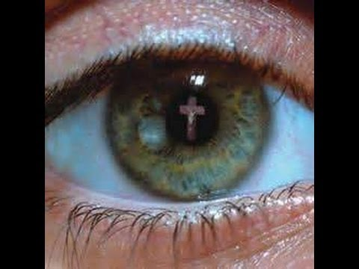
“The man can’t see because I AM the Light of The World!”

Slide 4
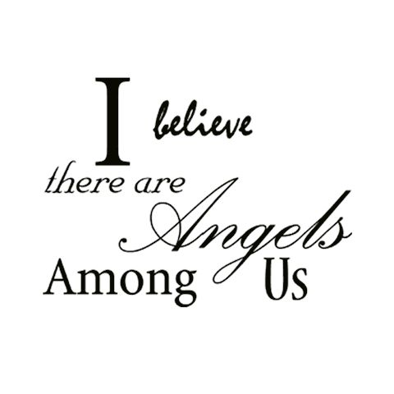

Slide 5
St. Paul says it beautifully about the Lords’ direct commission as delivered to him, “to open the eyes (sec. of the Jews and the Gentiles), so that they may turn from darkness to light and from the power of Satan to God, that they may receive forgiveness of sins and an inheritance among those sanctified by faith in Me.” (Acts 26:18)

Slide 6
Holy Spirit “delivers us from the domain of darkness and transports us to the kingdom of His beloved Son.” (Colossians 1:3)

