Slide 2
O yes indeed, money can buy you anything in this world!

Slide 3
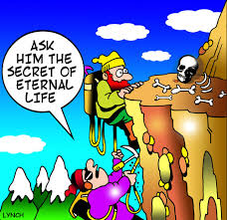

Slide 4
“For we brought nothing into this world and it is certain we can carry nothing out; and having food and raiment let us therewith be content.” (Hebrews l3:5)

Slide 5
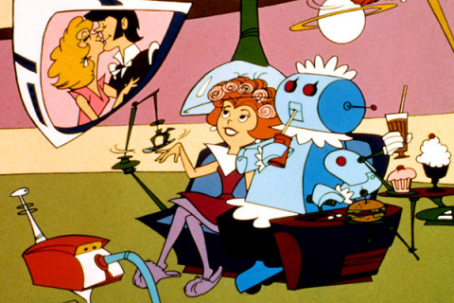
Maybe what we don’t know we don’t have sounds convoluted, but the sensibility comes when what we’ve just bought doesn’t bring relief for the idea of obtaining something better.

Slide 7
Spiritual Blessings we don’t muse upon normally.
Evil does not constrain Us.
Forgiveness is quite natural to all
believers.
Circumstances are circumstantial.
The Universes are full of God’s glory.

